Slide 1

Offuture Wrapped
2011-2014
Notes:
Hello everyone thank you for coming today!
First of all I’d like to take this opportunity to thank offuture for choosing Digital Futures for this project.
And without further ado, let's move onto the agenda for this presentation.

Slide 2
Agenda
Yearly figures
Profit per Segment
Monthly Figures
Profit by Market
Profit By Country
Profit by Category
By Sub-Category
Best and Worst Performing Products
Tables
Discounts
Questions
Notes:
To begin with, we are going to look at the broader trends of offutures’ sales during this time period
Looking at the yearly figures and profit by segment per year.
We are then going to move on to monthly figures, before breaking profit down by Market, Country, Categories and products/
Finally, we are going to discuss our findings on Tables and discounts specifically before taking any questions.

Slide 3
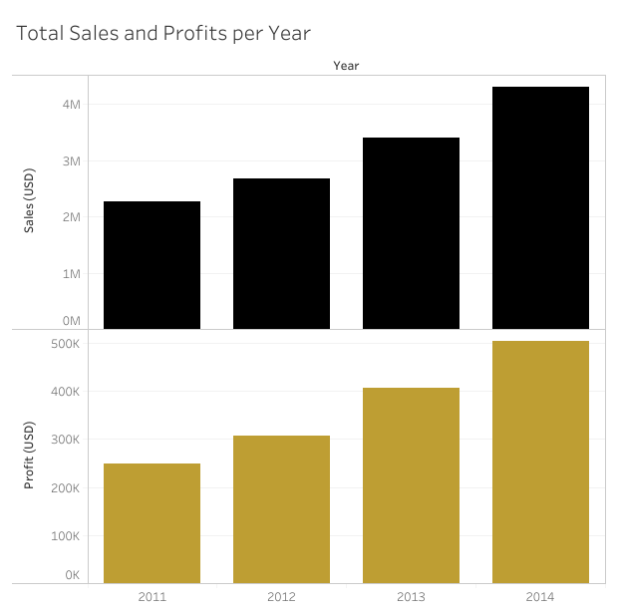
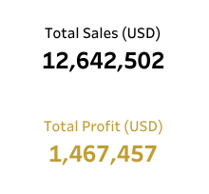
Yearly Figures
Both sales and profits increase year on year
These ought to be correlated - from the visualisation we can see this to be true
Notes:
102.524% increase in profits
between 2011 - 2014
Average 26.6% YoY

Slide 4
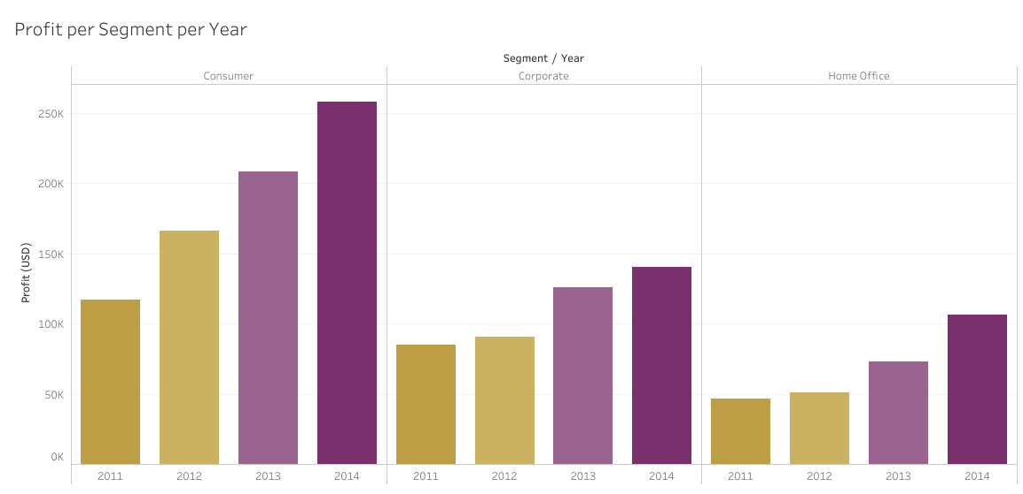
Profit per Segment

Slide 5
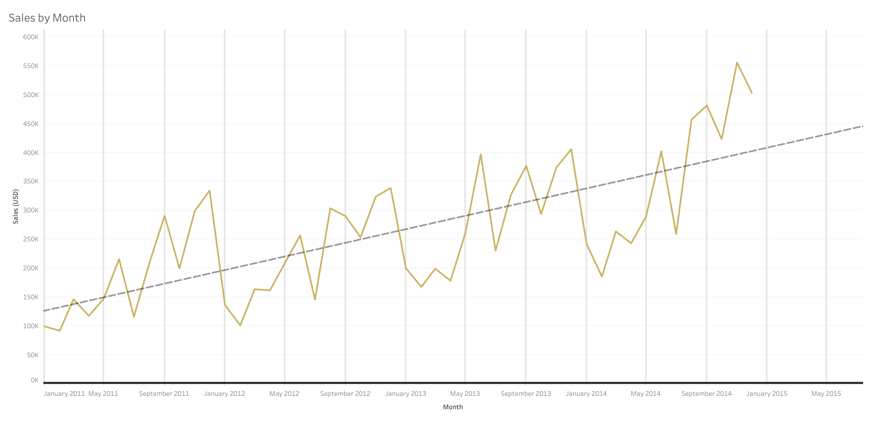
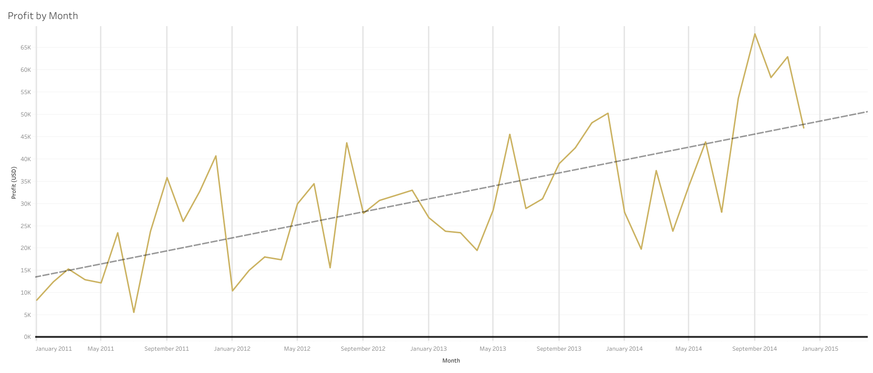
Monthly Figures
Trend of increasing sales and profit
Clear pattern of decreased buying during the first few months of each year.
Notes:
Here we’ve plotted Offutures’ profits and sales by month over the time period given to us.
As you can see the graphs are very similar, and show a trend of increase in both Sales and Profit.
By breaking it down by Month, we were able find a clear cyclical pattern of decreased buying in the first 4 months of the year from Jan to April and increased buying in the later months

Slide 6
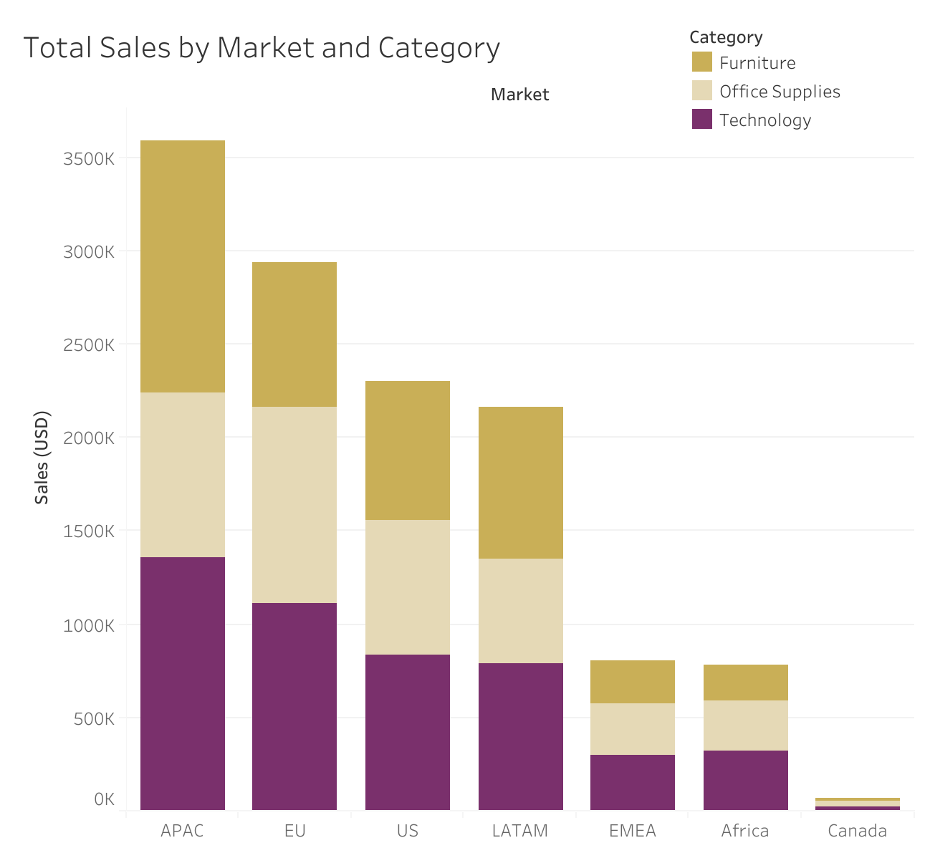
Profits by Market
Asia-Pacific (APAC) Market is the most lucrative
Africa, EMEA and Canada are the least lucrative
Notes:
Breakdown of profits by Market.
Asia-Pacific Market is the most lucrative: (biggest contributors China, India, Australia)
Canada is notably the smallest, disproportionately smaller than the US despite having a population only about 10 times smaller.
Roughly equal split between categories of products in each market, no significant imbalances.
EMEA – Europe, Middle East, and Africa
LATAM - Latin America

Slide 7
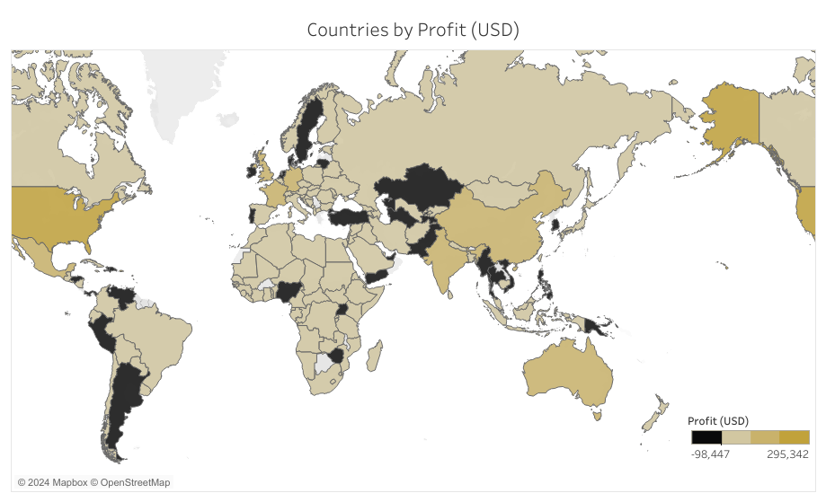
Profits by Country
Countries in black are making losses
Shaded countries show profits
No data for countries that are greyed out e.g. Iceland

Slide 8
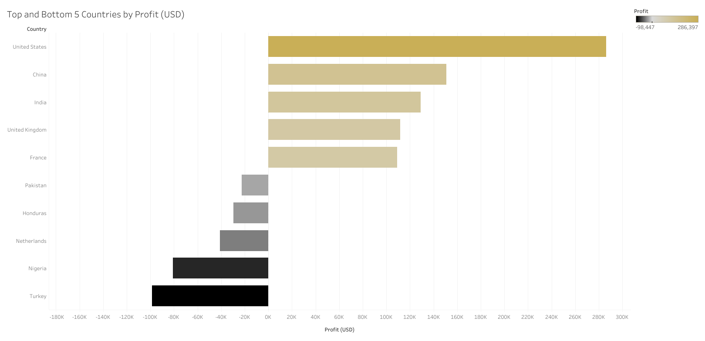
Profits by Country
Sales in the United States lead to the most profit ($286,397).
Sales in Turkey lead to the least profit($-98,447).
Notes:
Here we’ve broken Profit down by country.
We found the United States was your most profitable country by a significant number.
Over this time period Offuture made $296,397 in profit.
On the other hand we found that the company made its biggest loss in Turkey
Here Offuture lost $98,447.
This loss was closely followed by Nigeria.

Slide 9
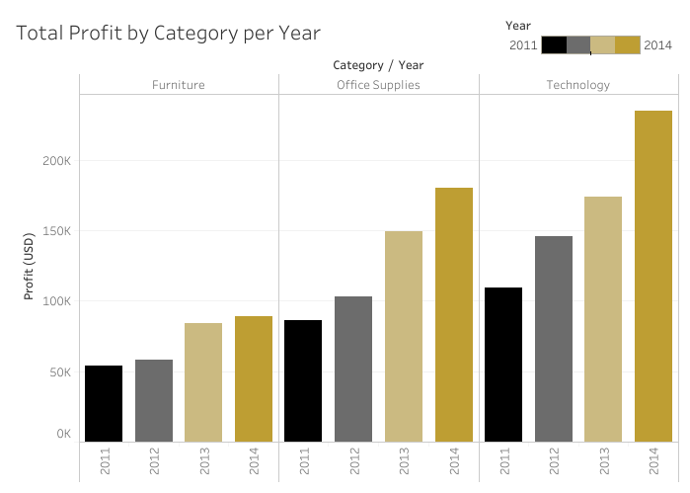
Profit By Category
Technology is consistently the most profitable category year-on-year
Profits are increasing in each category year-on-year
Notes:
Office supplies have highest number of orders (~30,000) then tech and furniture (~10,000 each)

Slide 10
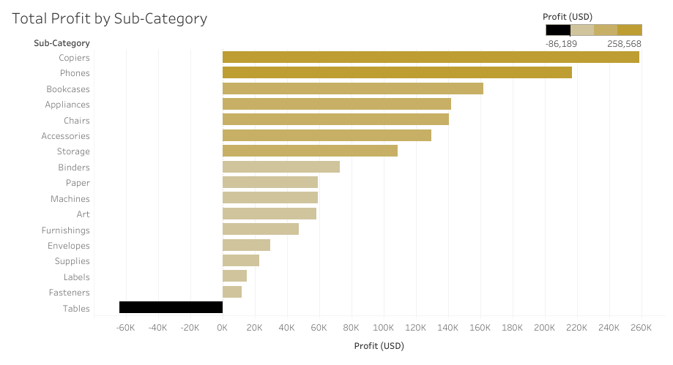
Profit By Sub-Category
Copiers are the most profitable sub-category
Tables are the ONLY sub-category not making a profit

Slide 11
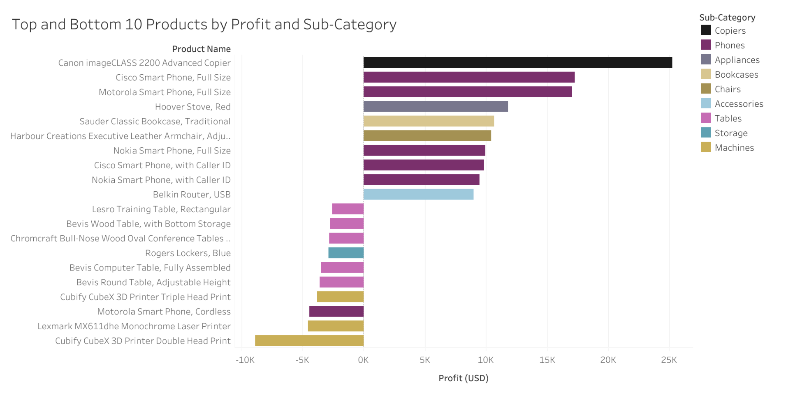
Best and Worst Performing Products
Notes:
Best and worst performing products:
A copier is the most profitable by quite a margin.
Smart phones make up half (5 of the 10) most profitable items (although one Motorola Smart phone appears in the least profitable category).
The least profitable categories are TABLES (5 out of 10) of the least profitable items, and machines (3 out of 10).

Slide 12

Tables?
Notes:
What is going on with tables. As offutures biggest losing subcategory, we decided to look more closely as to what was causing this loss.

Slide 13
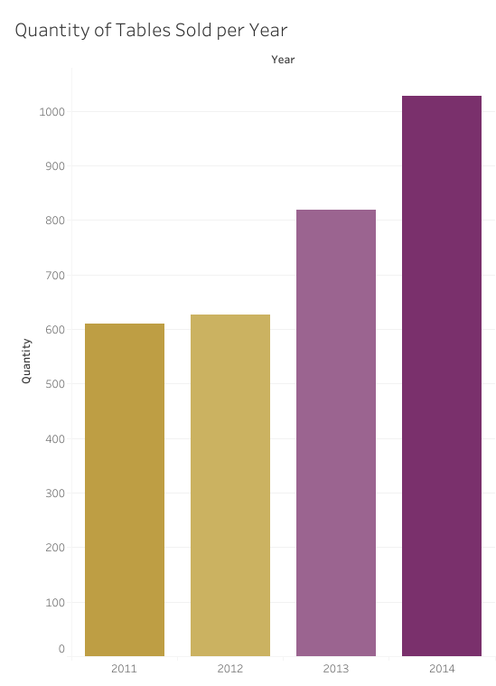
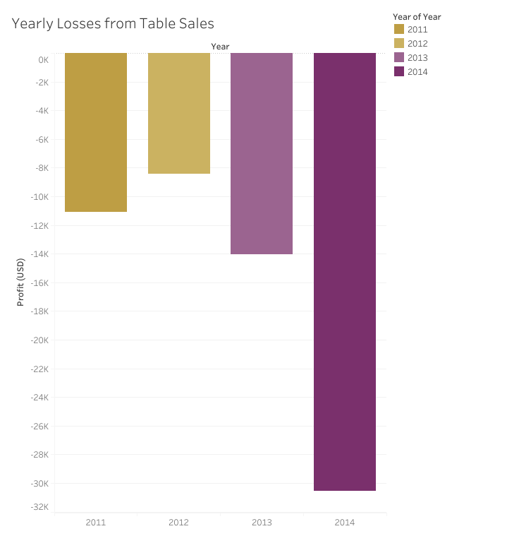
Tables!
Notes:
We can see that the number of tables sold has been increasing year on year, unfortunately this leads to a greater and greater loss. In 2014 compared to 2013 the amount of loss almost doubled.

Slide 14
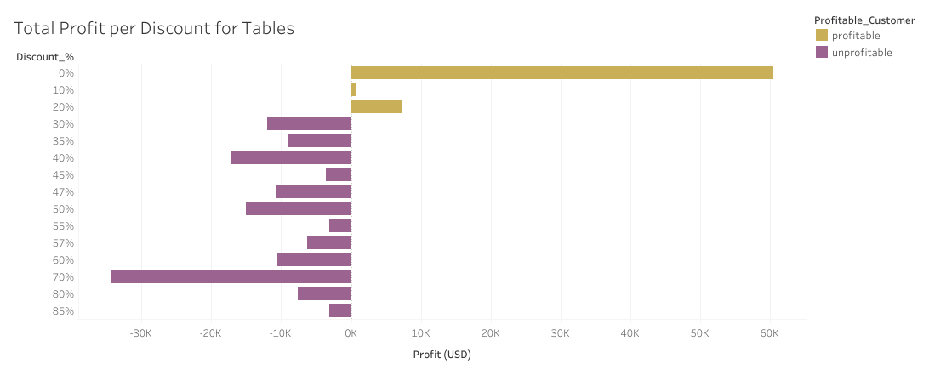
Tables
Notes:
As seen with average profit, the total summed profit per discount also shows that discounts over 20% are creating losses for Offuture.
So far the discount investigation has only been done on the tables subcategory. So we decided to look over the whole to see if there was a similar trend in
– so we explored

Slide 15
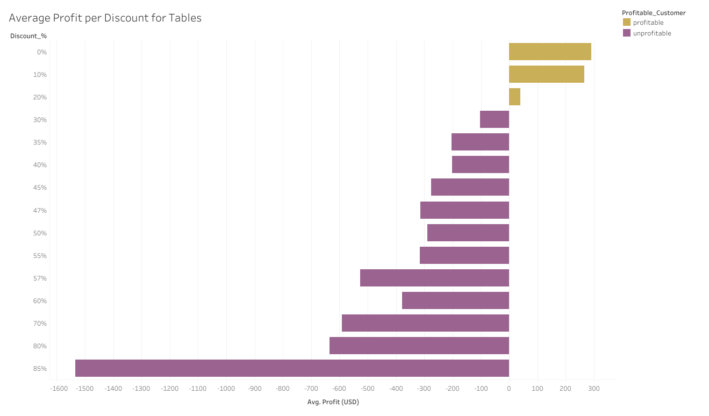
Tables
Notes:
To investigate where the money was leaking out of table sales, we looked into the average profit of selling a table across the various discounts that Offuture offers. This graph shows that on average. Tables being sold at a discount rates above 20% were losing money.

Slide 16
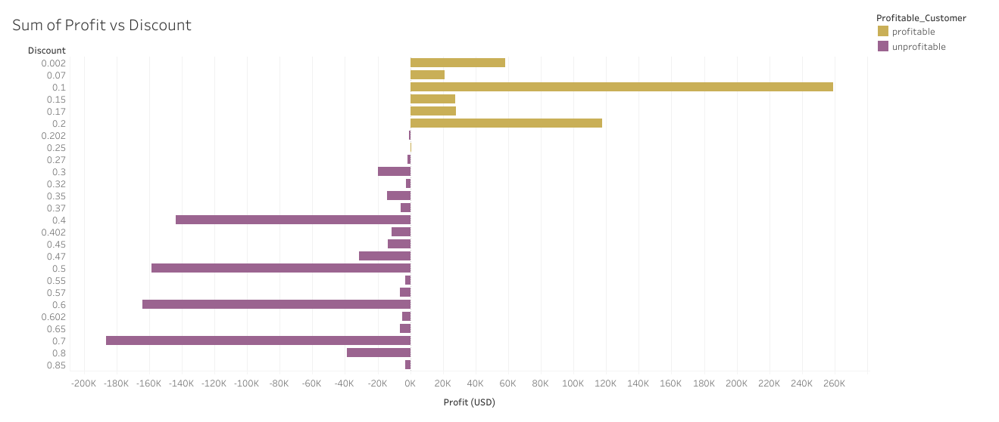
Discounts
Notes:
This shows the total profits vs the discount rate for all the products. Once again, there is a switch from profitable to unprofitable when discounts get over 20%. In this graph, non-discounted products (0%) was excluded as it was extremely large relative to the other sums.

Slide 17
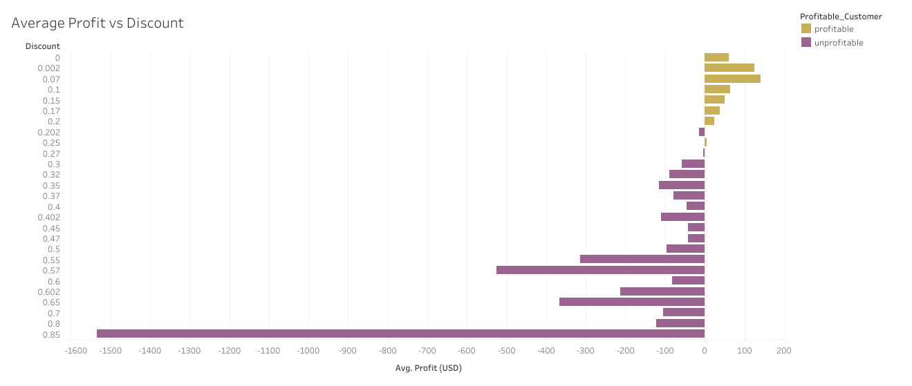
Discounts
Notes:
Now looking at the average profit we can reinforce the idea that post 20% discount on average makes a negative profit.

Slide 18
Discounts
Discounts above 20% are losing money across the board, not just tables!
How does the discount on a product relate to the quantity sold?

Slide 19
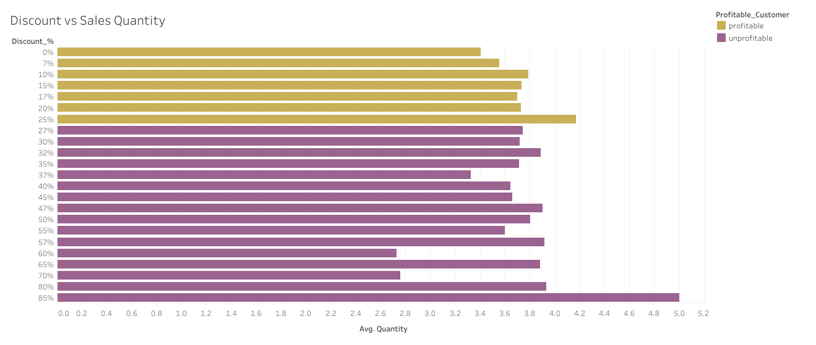
Discounts

Slide 20
Thank you for listening!
Questions?

